Slide 1
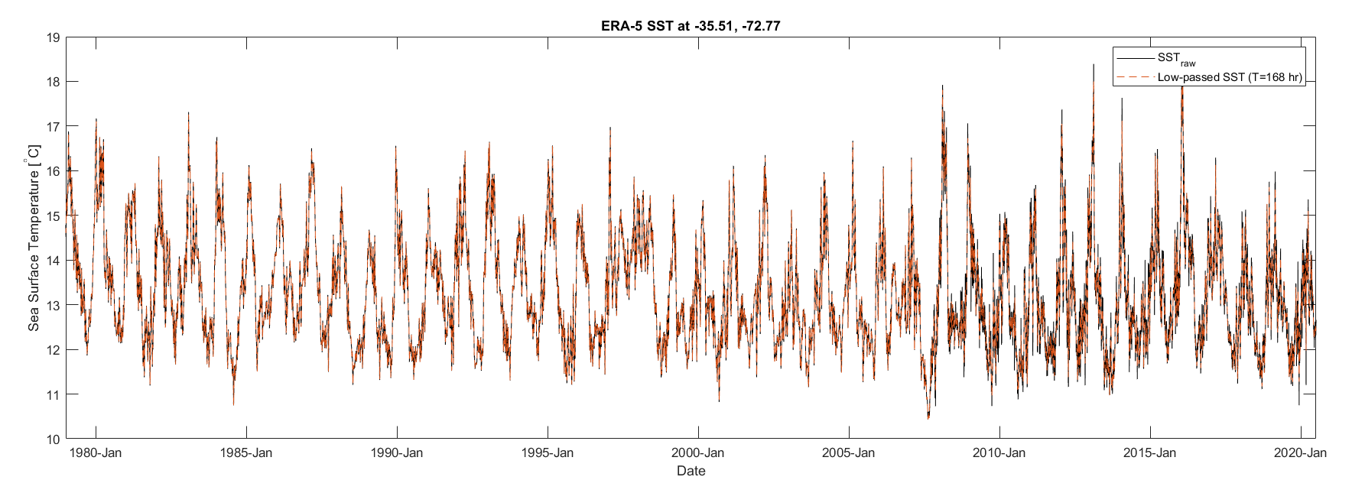
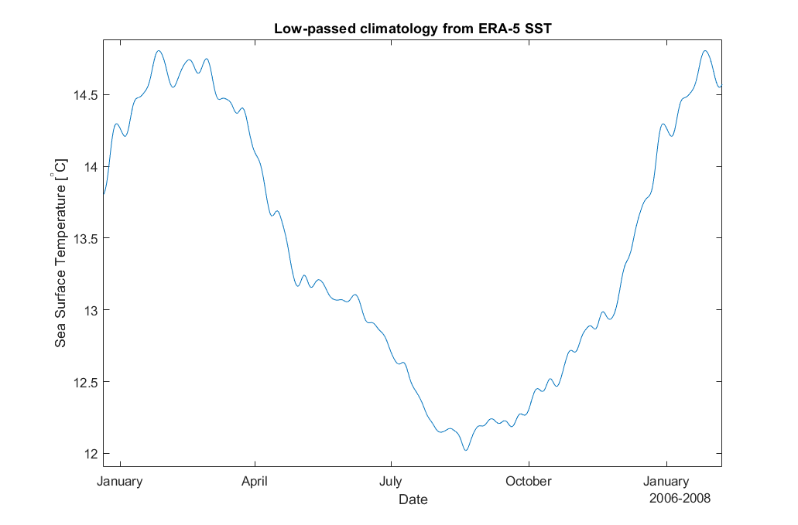

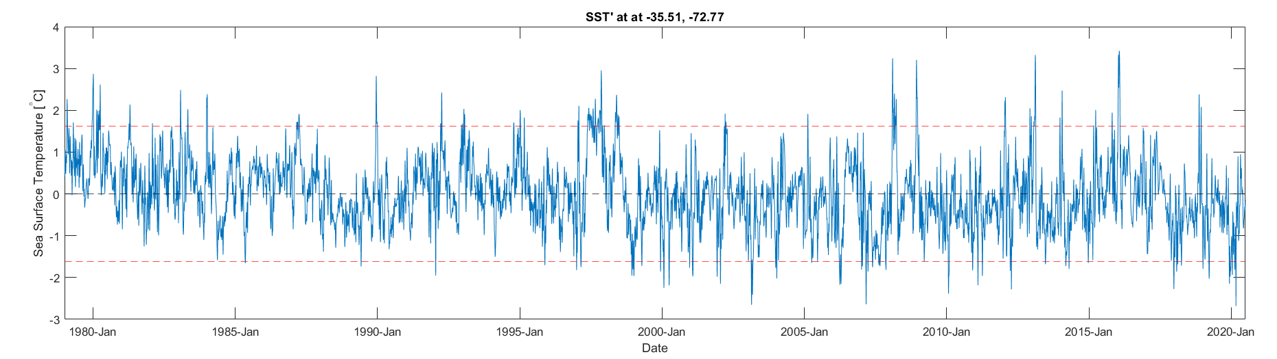
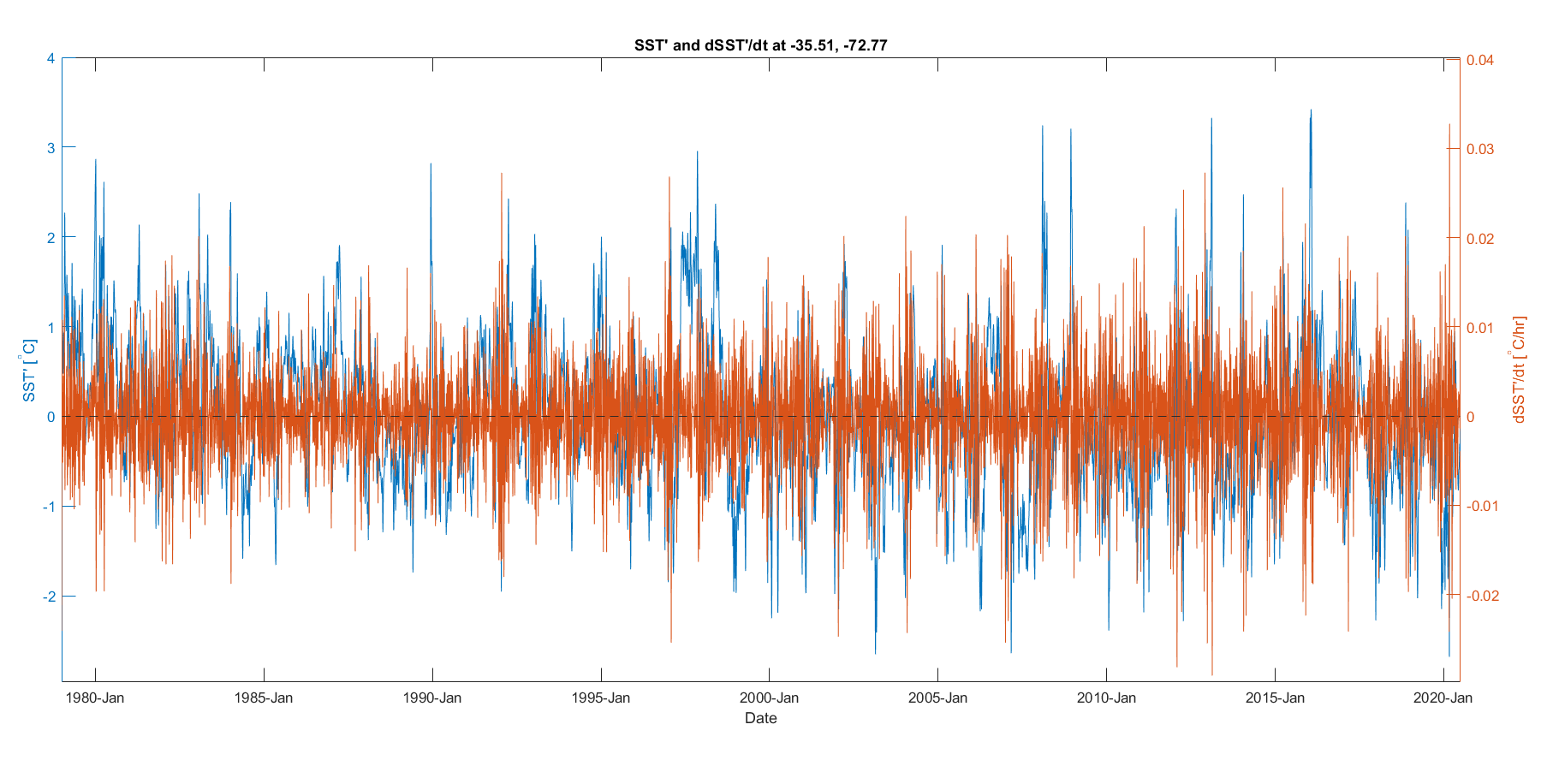
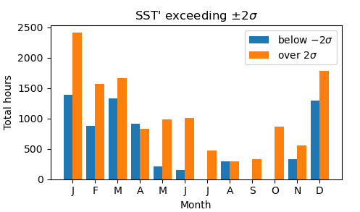
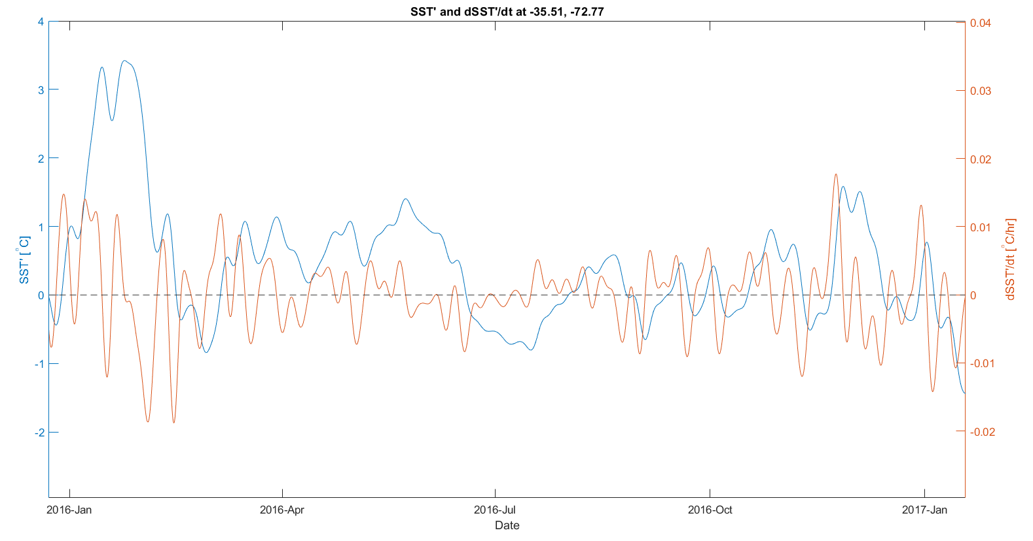
Marine heat waves in the Chile-Peru Eastern Boundary Upwelling System:
~~~~Ammo Bar ~~~~
rates of change in sea-surface temperature anomalies near a major upwelling center
Of all SST anomalies in the Punta Lavapie Upwelling Center, the most extreme are dominated by positive anomalies which occur most often in December through February.
Presenter:
Kylene Cooley
Background:
Marine heat waves like those in the California Current System (CCS) have also been observed in the Chile-Peru System (CPS)
Dominant forcings of wind relaxations in the CCS have been found through analysis of the surface ocean heat budget
Methods:
Obtain European Centre for Medium-Range Weather Forecasts reanalysis (ERA5) hourly SST
Define periods of intense warming as departures from climatology
Sort these times based on annual and seasonal occurrence
Take time derivative of SST’ for rates of anomalous warming
Authors:
Kylene Cooley, Melanie R. Fewings, Jim Lerczak
Oregon State University, CEOAS
cooleyky@oregonstate.edu
Future Work:
examine terms in the sea surface heat budget for which are dominant during different times
References and Acknowledgements: Flynn et al. (2017)

Slide 2
Marine heat waves in the Chile-Peru Eastern Boundary Upwelling System:
rates of change in sea-surface temperature anomalies near a major upwelling center
Presenter:
Kylene Cooley
cooleyky@oregonstate.edu
Authors:
Kylene Cooley, Melanie R. Fewings, Jim Lerczak
Oregon State University, CEOAS

Slide 3
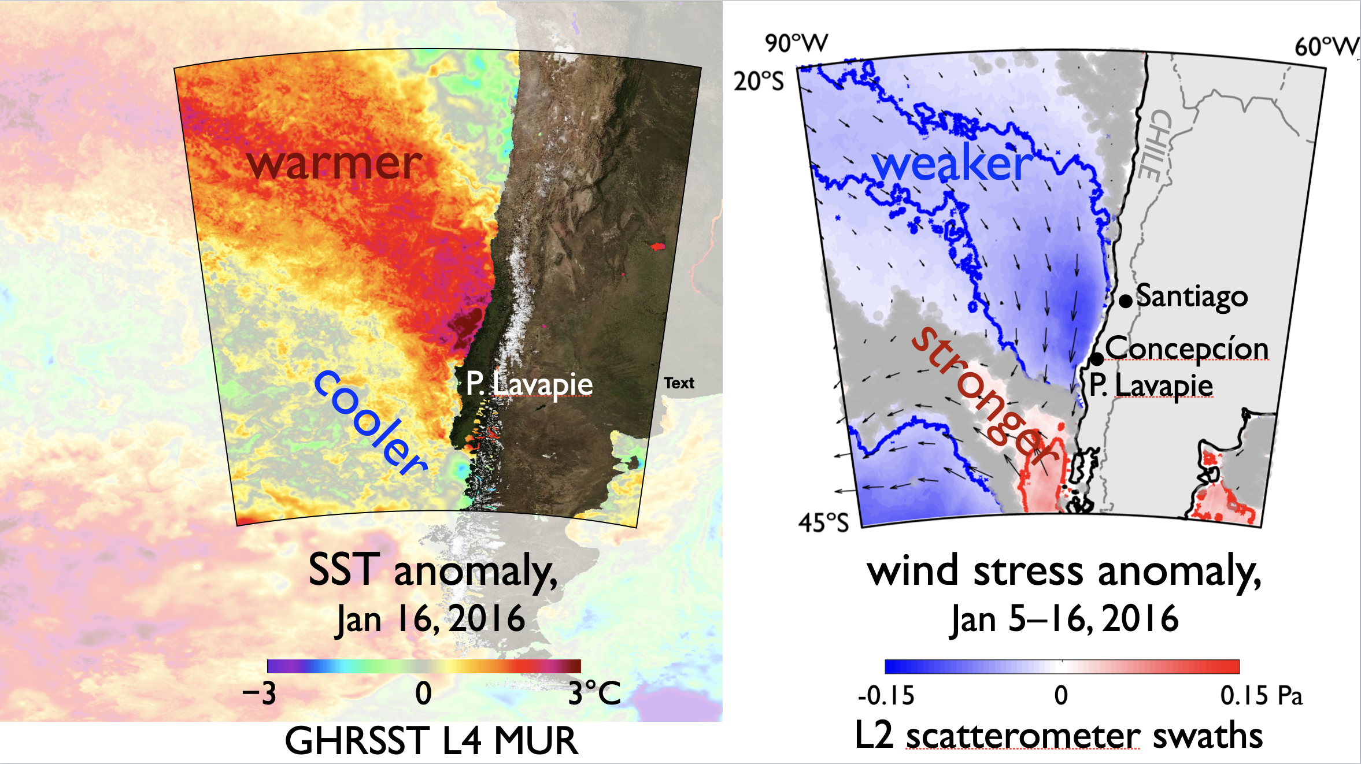
Marine heat waves (MHWs) affected the Chile-Peru System (CPS) in 2014-2016 and 2019-2020
Background:
The relationship between SST and wind stress anomalies in the California Current System (CCS) during MHWs have also been observed in the CPS
Similar dipole structures as in Fewings and Brown 2019

Slide 4
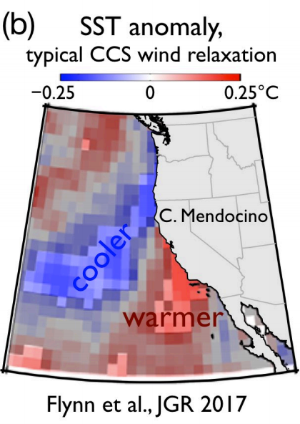
Dominant forcing mechanisms of the surface ocean heat budget in the CPS during MHWs are not well defined.
Dominant forcing mechanisms of wind relaxations in the CCS have been found through analysis of the surface ocean heat budget
Surface latent heat flux
Decreased entrainment and Ekman pumping at the mixed layer base
Flynn et al. (2017)

Slide 5
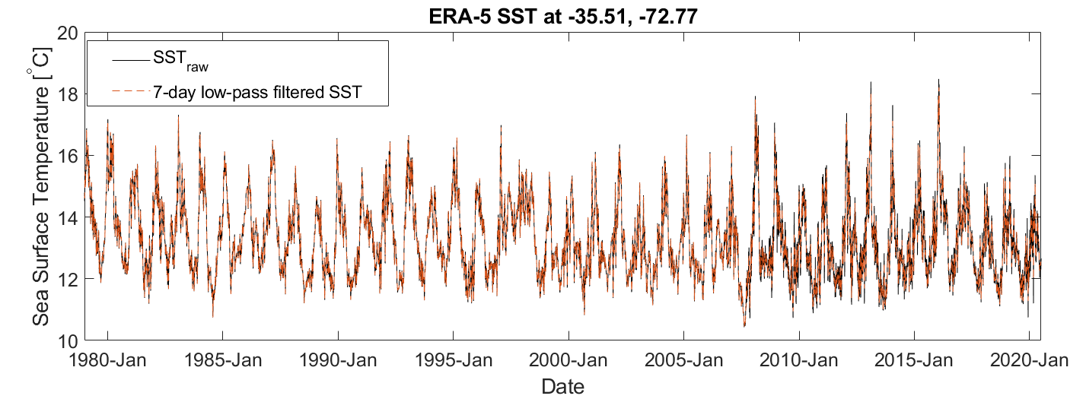
Isolating strong warm anomalies in CPS
We use SST near Punta Lavapié upwelling center from 5th generation European Centre for Medium-Range Weather Forecasts reanalysis (ERA5)
Notes:
Methods:
Obtain European Centre for Medium-Range Weather Forecasts reanalysis (ERA5) hourly SST 1979-2020
Low-pass filtered to exclude 7-day and faster periods with pl66 filter

Slide 6
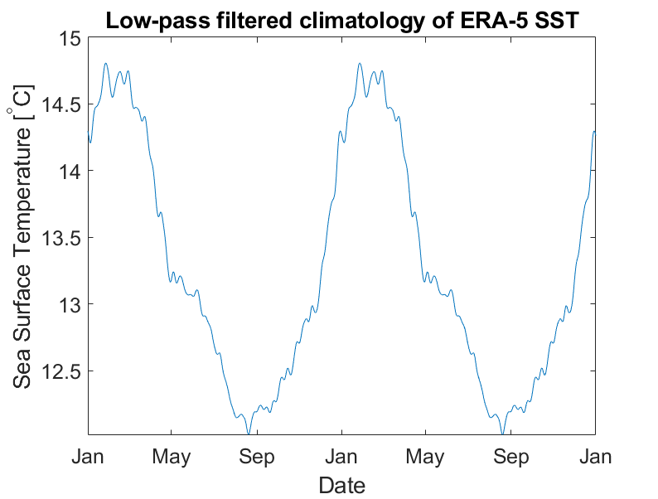
Isolating strong warm anomalies in CPS
First, we calculate the climatological annual cycle
Notes:
Climatology derived from ERA-5 SST and processed with 7-day pl66 filter

Slide 7
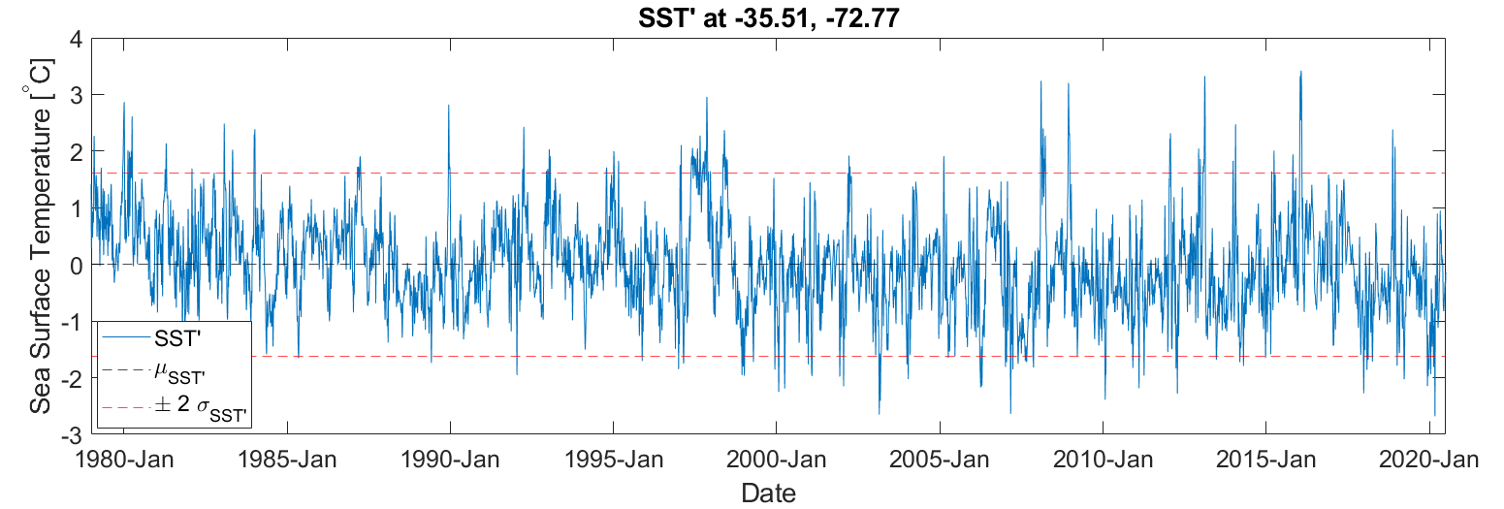
Isolating strong warm anomalies in CPS
We focus on periods of intense warm anomalies where SST’ exceeds two standard deviations from the mean
Notes:
Mention that SST’ is the SST anomaly
Points above top red line

Slide 8
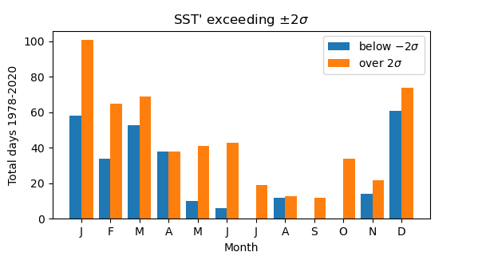
Isolating strong warm anomalies in CPS
Strong warm (and cold) anomalies occur most often in December through March

Slide 9
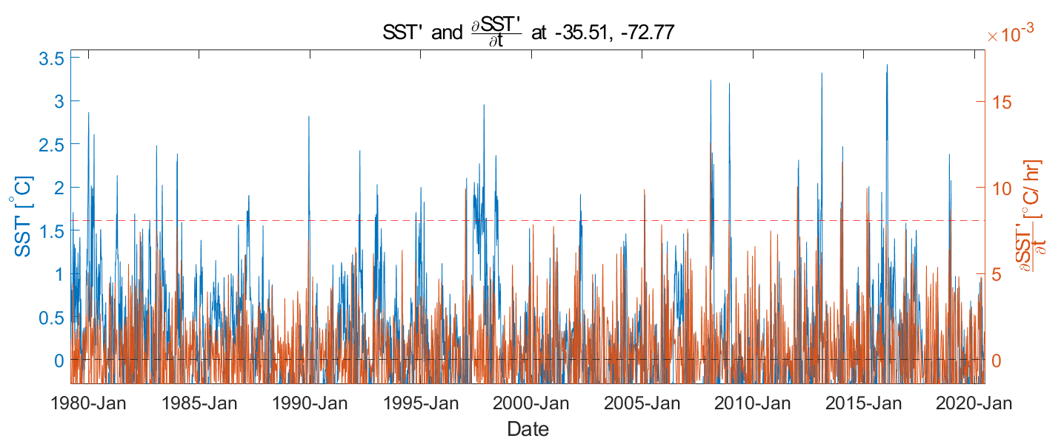
Calculating rates of anomalous warming
Estimate time derivative of the temperature anomaly, SST’

Slide 10
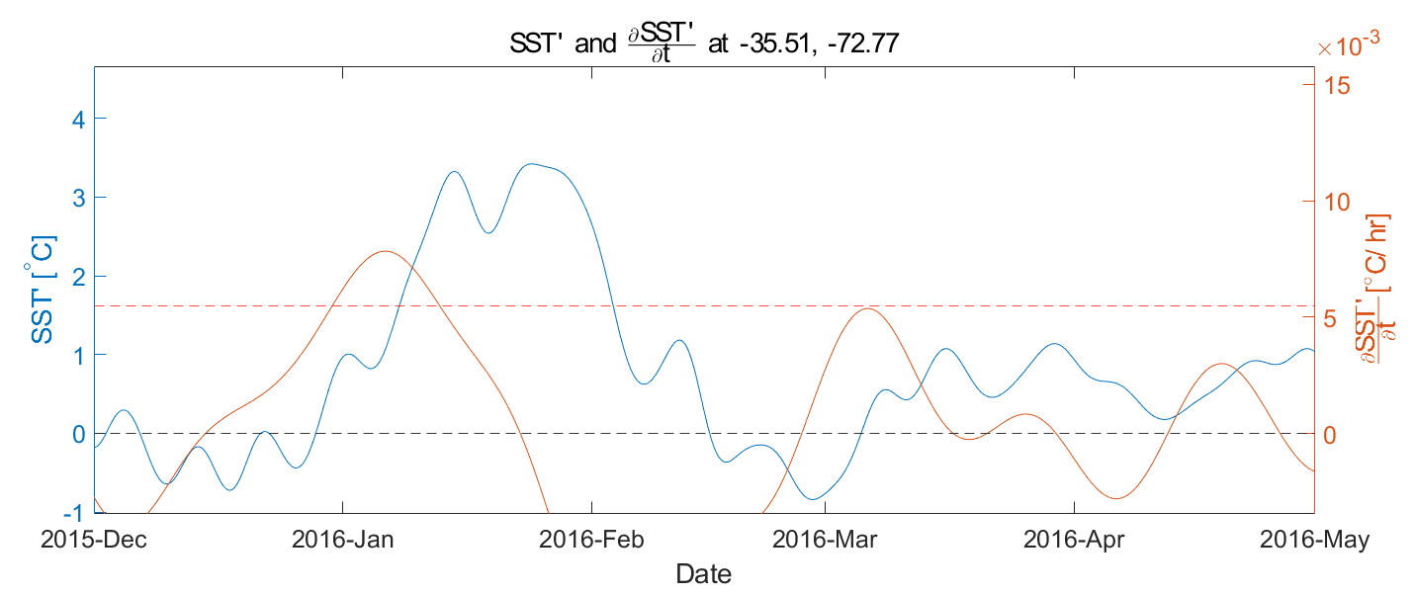
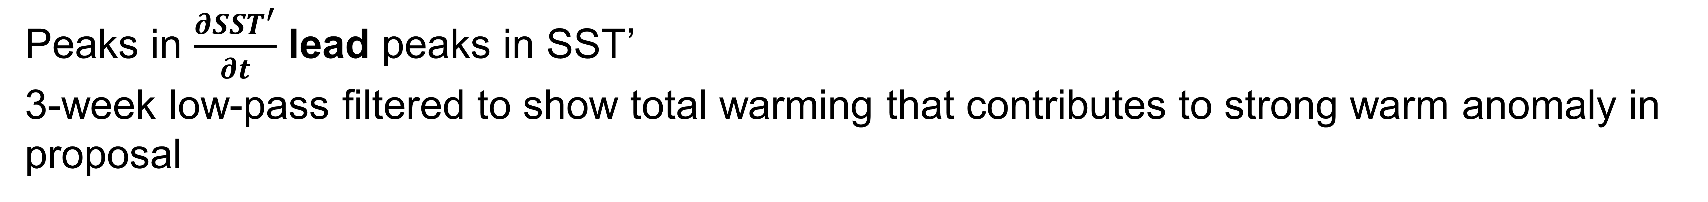
Calculating rates of anomalous warming
Peaks in $\frac{∂SST^{′}}{∂t}$ lead peaks in SST’
3-week low-pass filtered to show total warming that contributes to strong warm anomaly in proposal
Notes:
In one year we can better see how periods of ocean surface heating precede the warmest events. Especially peak in SST’ in Jan of 2016 which was highlighted in the proposal.
Three episodes of stronger warming contributed to highest peak in SST’.
+dSST’/dt inform when to calculate surface ocean heat budget terms

Slide 11
Future Work:
•Sea surface mixed layer heat budget following Flynn et al. 2017; Fewings and Brown 2019
•Examine which terms are dominant leading to warmest periods
•Utilize satellite ocean vector wind data, ERA5 and satellite-derived air-sea heat fluxes OAFlux and SeaFlux
What do I hypothesize finding?
Different forcing mechanisms in northern and southern regions
Warming in northern region mimics CCS equatorward forcing mechanisms:
Decreased entrainment and Ekman pumping at mixed layer base
With additional warming driven by:
Advection of SST gradients from warmer regions/equator
Changes in cloudiness

